Slide 1
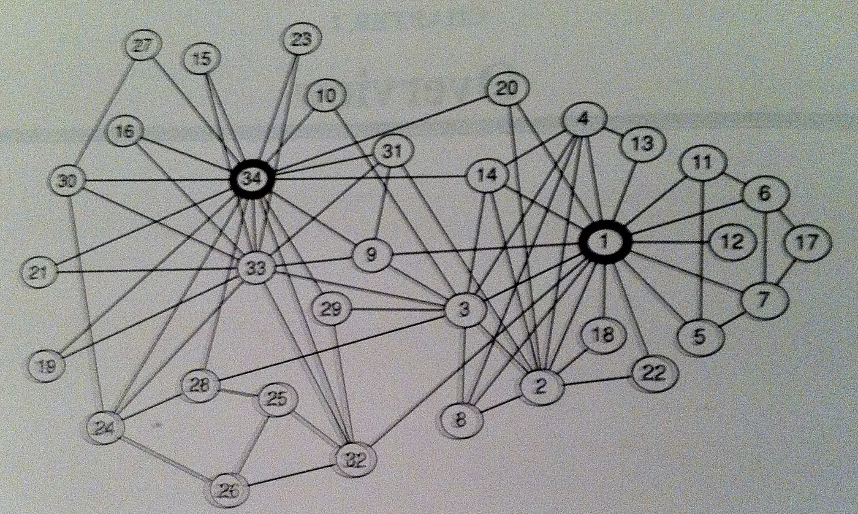
Friends?
Notes:
University karate club members
Comes from a 1970 journal of Anthropology

Slide 2
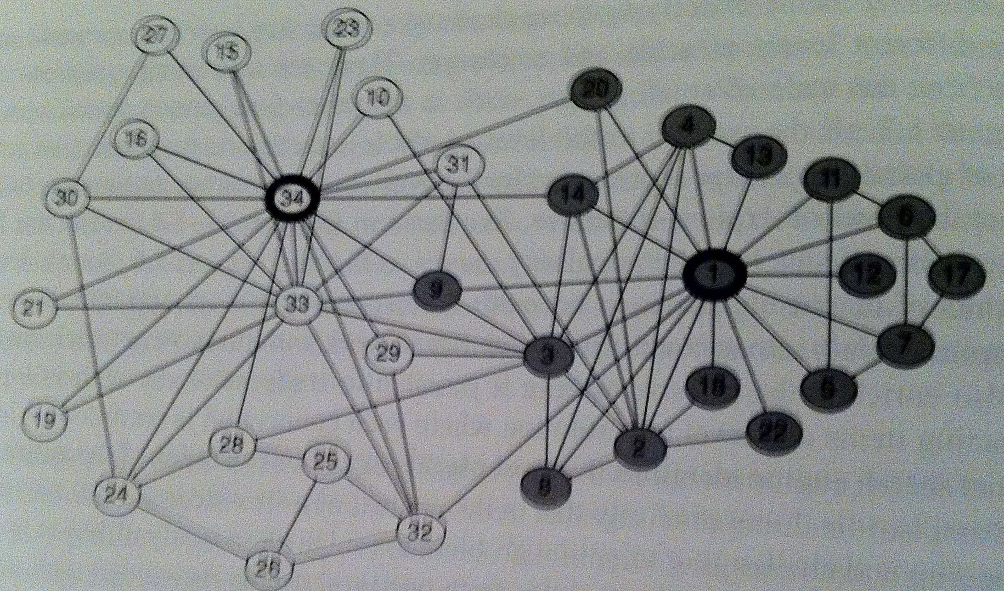
Not so much
Notes:
Cliques!
Split by instructor – paid instructor versus student leader
Eventually leads to 2 karate clubs

